Slide 1
ITLP Innovation Project
Inventory Location Tracker
07/29/16
Emily Herbert & Kyle Hudgins
Notes:
Kyle

Slide 2
Intro
Notes:
Kyle

Slide 3


Intro
Emily Herbert
Technical Development
Kyle Hudgins
Project Planning &
Development

Slide 4


Intro
Lily Thomas
Manufacturing Shop
Operations Manager
Lindsey Elliott
Engineering EID Intern

Slide 5
The Problem
Notes:
Emily

Slide 6
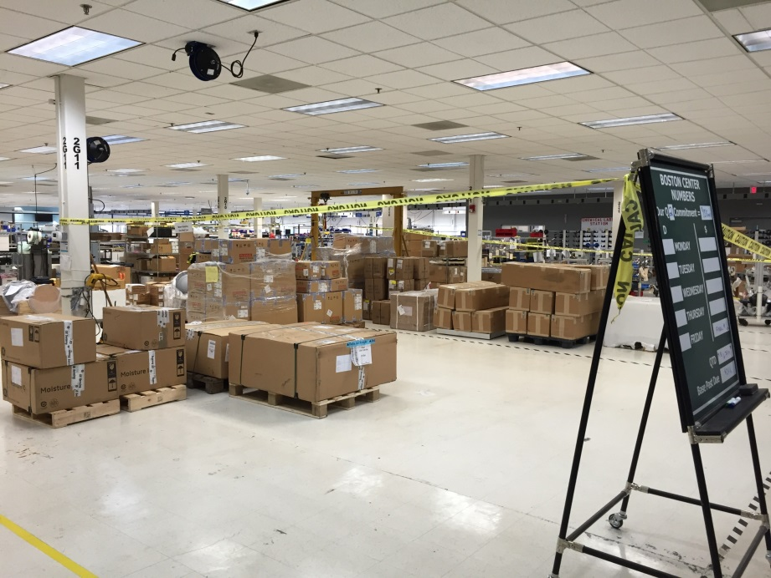
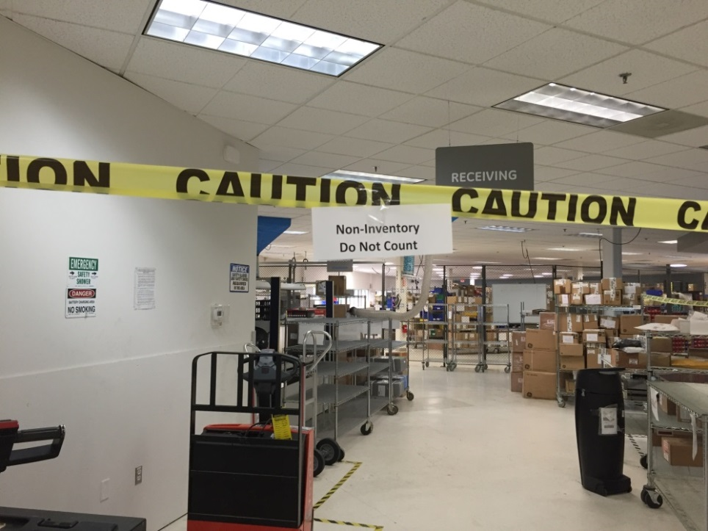
The Problem
High value assets go missing on the shop floor.
The total cost of missing flow cells last year totaled approximately $40,000 at just the Billerica site.

Slide 7
Solution
Notes:
Kyle

Slide 8
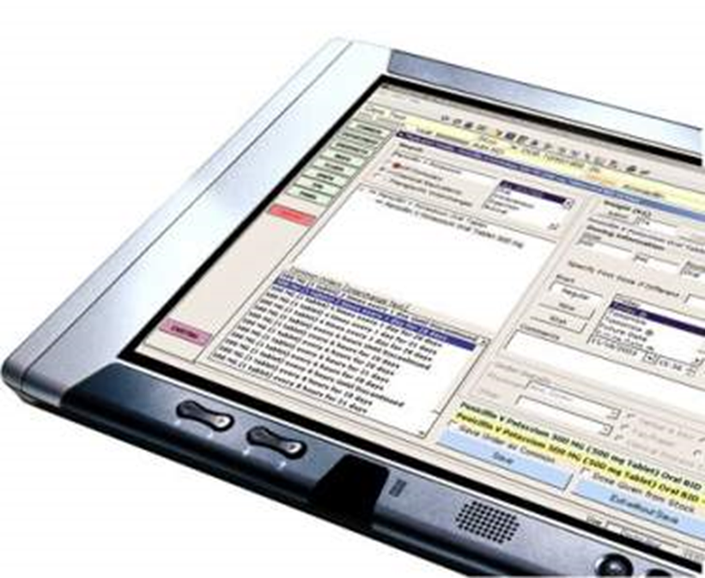
Solution
Create a system to track high value assets on the shop floor in real time and to display each asset’s location as accurately as possible.

Slide 9
The Technology
Notes:
Emily

Slide 10
Raspberry Pi 3 Model B
A Raspberry Pi is a small, low-cost computer allowing for a range of different applications.
Pi’s talk to each other to determine approximate location.

Slide 11
Estimote Bluetooth Beacon
Wireless sensor.
Equipped with an Accelerometer, Temperature Sensor, and Bluetooth SMART (Bluetooth LE).
Notes:
What is an estimote beacon?
Bluetooth native to Pi.

Slide 12
Estimote Bluetooth Beacon
Multiple Estimotes will be tagged onto high-value assets to track them via Bluetooth.

Slide 13

Raspberry Pi & Estimote Integration
Beacons
Location!
(via closest Pi)
Advertisement
Packets
Received Signal
Strength Indicator
(RSSI) Value

Slide 14
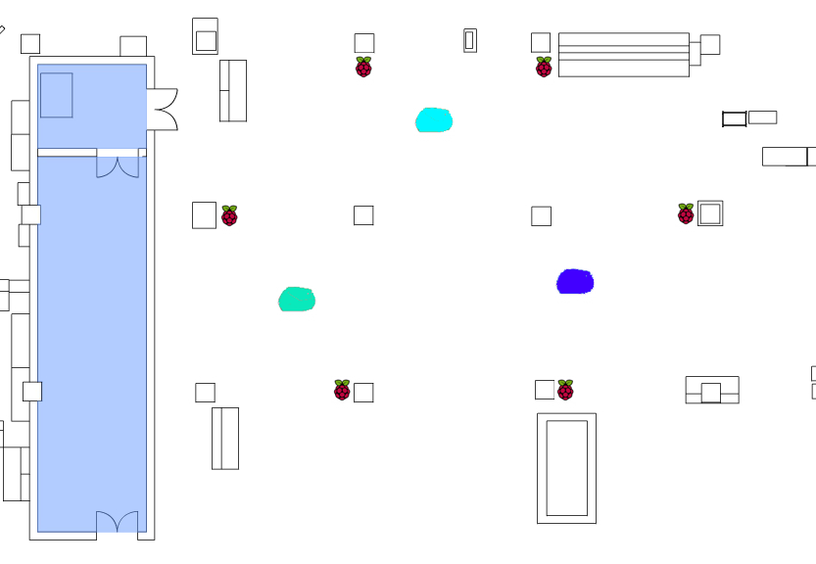

Slide 15
Steps so far
Notes:
Kyle

Slide 16
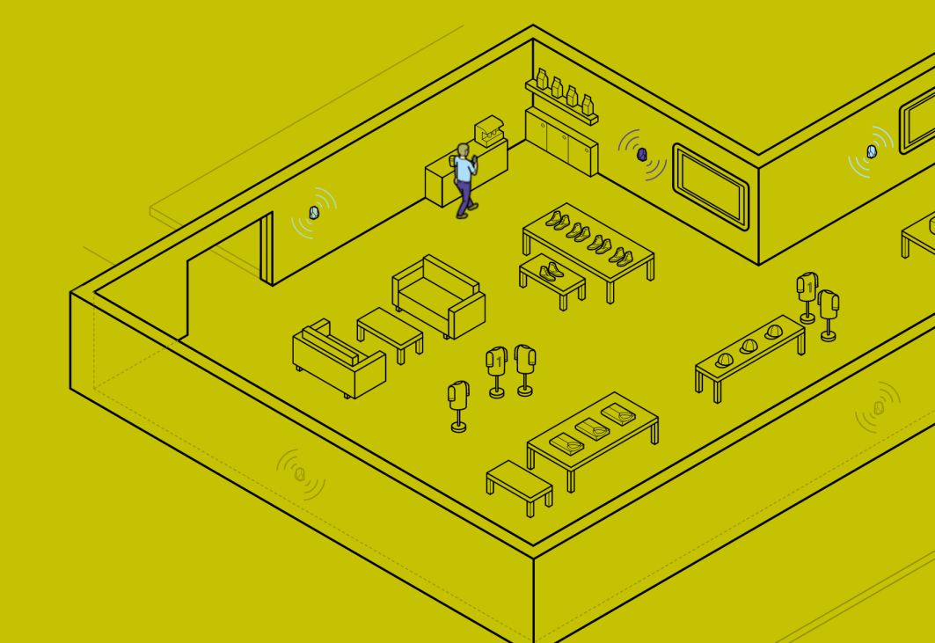
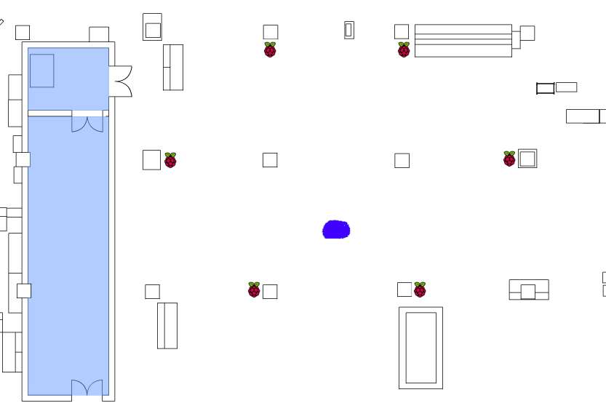
Raspberry Pi & Estimote Integration
Needed to rework how an Estimote works.
Expected Use: Our Use:
“Earth rotating around Sun”
“Sun rotating around Earth”
Notes:
Currently, Estimotes are meant to track devices such as cellphones by attaching them around a perimeter of a room. However, this option is not feasible as we could not attach raspberry pi’s as sensors to every asset due to cost, power constraints.

Slide 17
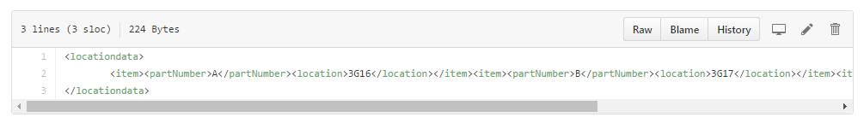
Raspberry Pi & Estimote Integration
Built system that …
allows Pi’s to store data in one location
allows Pi’s to communicate
allows user to see location of any Estimote

Slide 18
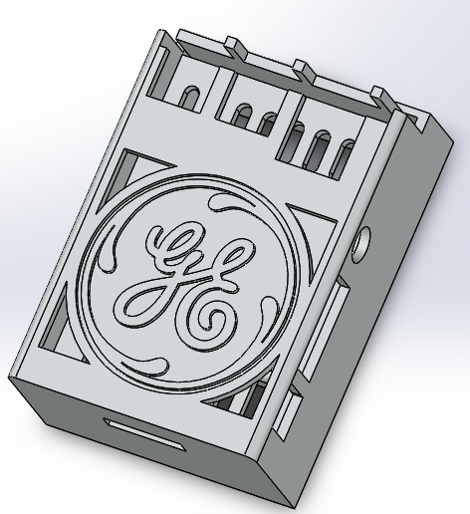
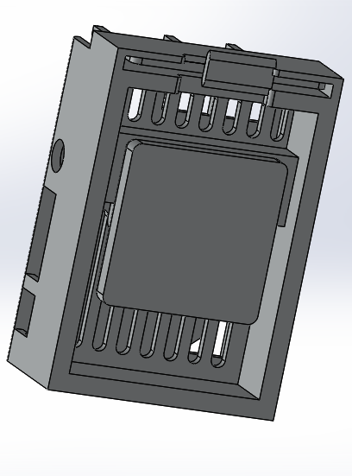
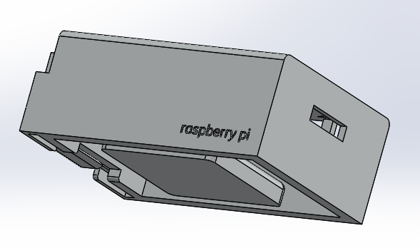
Additive Manufacturing
Needed to create custom cases for the GE shop floor.

Slide 19
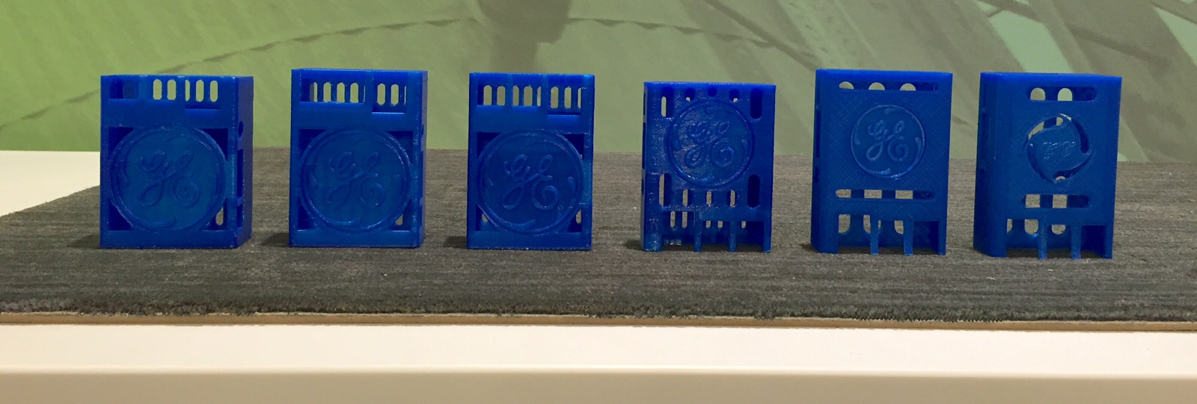
Additive Manufacturing

Slide 20
Current Work
Notes:
Emily

Slide 21
GUI
Creating GUI for user to enter part numbers when assigned to Estimote
Create map of shop floor for easy viewing of locations

Slide 22
Potential Roadblocks
Notes:
Emily

Slide 23
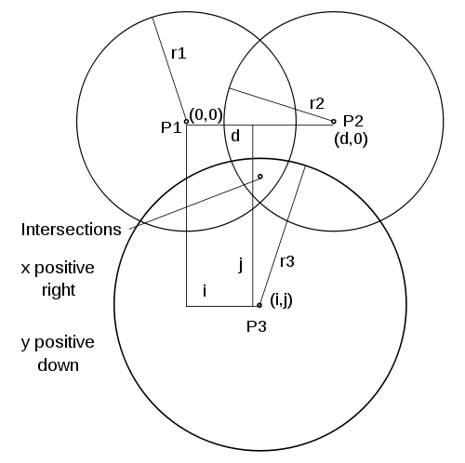
Precise Location Tracking
Estimotes work on proximity and not exact location. Our system indicates which Pi is closest to Estimote.
Solution: Triangulation using the RSSI signals from one Estimote to 3+ Pi’s.

Slide 24
Security Issues
Information Storage | Wireless Encryption
Location data must be hosted somewhere in order for it to be compiled and analyzed. This location needs to be secure and comply with GE security measures. | Possibility of unauthorized person receiving signal.
Solution: GE Enterprise Github Account. | Solution: Encrypt signal from Estimotes to Pi’s and from Pi’s to GitHub.

Slide 25
Deployment
Notes:
Kyle

Slide 26
Prototype Roadmap
Proximity Estimotes
Current Progress
June 20-29
August 5
August 10
Material Procurement
Working Prototype
Live Demo w/ ME Manager
Road to Implementation
System Intallation & Initial Testing
Development
Employee Training
July 5 - August 3
August 9
August 12

Slide 27
Deployment Budget
Location Estimotes
Full Implementation Cost: $2,336.50
25 Rpi’s + Charger + SD Card
26 Estimotes
Case Filament

Slide 28
4-Year Return On Investment (ROI)
Break-even Point: 21 DAYS
ROI: 67.4 Times!!!(6748%)
Total potential savings: $157,663.50

Slide 29
Future Applications
Notes:
Kyle

Slide 30

Future Applications
Brilliant Factory
More comprehensive planning for customer orders Eliminate manual cycle counting and physical inventory | Employees and customers can track product components during lifecycle Sensors can gather data on temperature, motion, light, etc.
“System pulls call of inventory and cross referencing official inventory with actual inventory. No interaction needed unless numbers are off.” | “The product was exposed to harsh temperatures 5 times on the shop floor” “The product was dropped 1 time on the shop floor”
Notes:
Eliminating Cycle Count and PI Day

Slide 31
Food for Thought
Technology is ever changing
Beacon technology developer friendly
Notes:
– new version of Estimotes being released soon.
could be produced by GE more efficiently and with more sensors.

Slide 32
Food for Thought
Portable Machinery!
Flow cells!
Computers!
Transducers!

Slide 34
Sources
https://upload.wikimedia.org/wikipedia/commons/thumb/7/72/Raspberry_Pi_2_Model_B_v1.1_rear_angle_new.jpg/1280px-Raspberry_Pi_2_Model_B_v1.1_rear_angle_new.jpg
http://developer.estimote.com/assets/gfx/tech-overview-1-aff2fd4b.png
http://developer.estimote.com/assets/gfx/tech-overview-2-e464c90e.jpg

Slide 35
Economic Feasibility Analysis (Location)

Slide 36
Economic Feasibility Analysis (Proximity)

